Slide 1

WP4 – AI-based DSS models and advanced analytics
T4.4 – AI models for rehabilitation activities scoring and progressive scheduling
Vassilis Tsakanikas
University of Ioannina

Slide 2
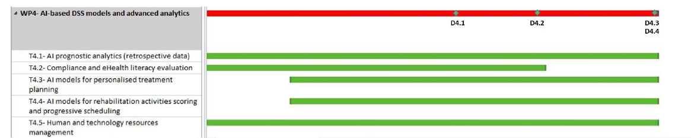
Task 4.4 : AI models for personalised treatment planning
Task Description
(Leader UOI, Participating partners: BRD, BIOIRC, ICCS, UCL, NKUA), [M7-M32].
AI models will be developed for exercise evaluation and performance scoring using an online and offline approach. The first is to perform real-time evaluations, ensuring proper and safe execution of activities, and providing corrective feedback to the patient through the AR physio. Offline scoring will be used for the clinical assessment of the patient after an exercise has been completed. This outcome will be then considered in progressive scheduling of activities. Progressive scheduling algorithms will be developed to automate day-to-day activities scheduling, in terms of modifications of difficulty level, type of activities in response to provoked symptoms, progression and response to treatment and user needs.
D4.1 TeleRehaB DSS AI models and advanced analytics v1.
This deliverable will provide the first version of the AI models in time for the start of the clinical study. [M18].

Slide 3
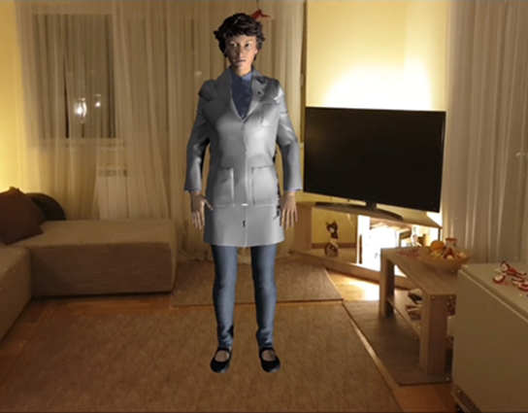
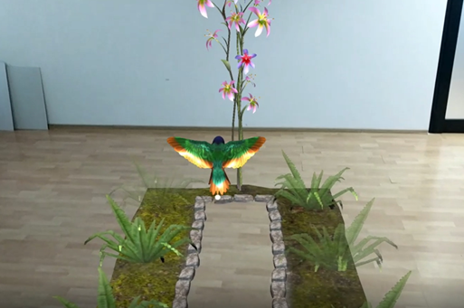
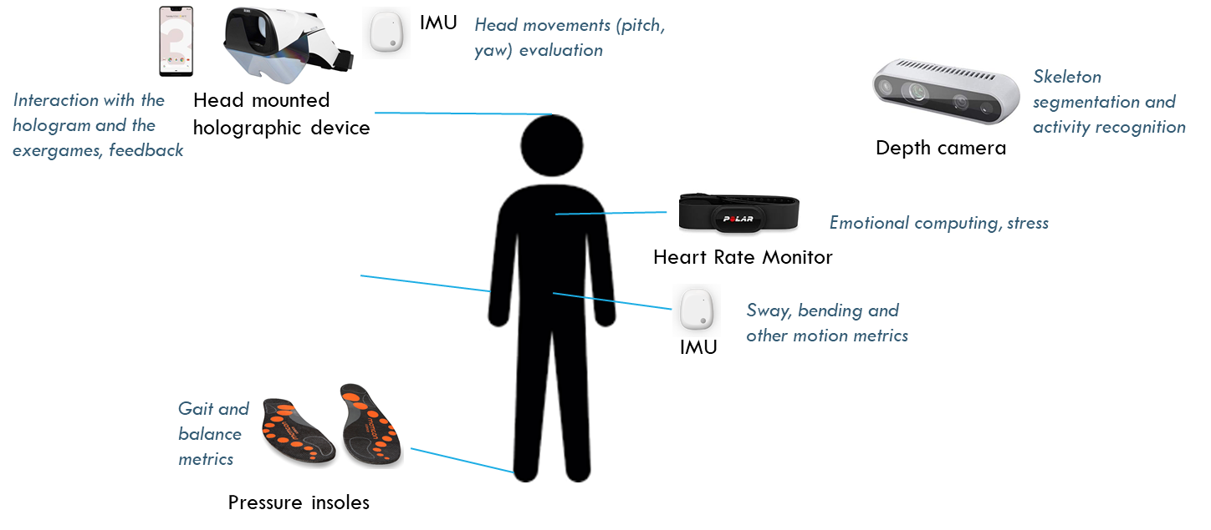
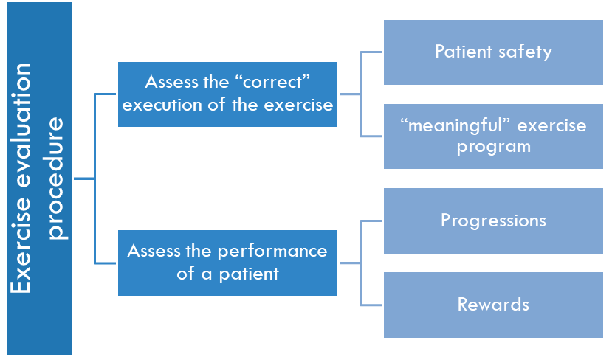
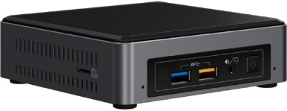
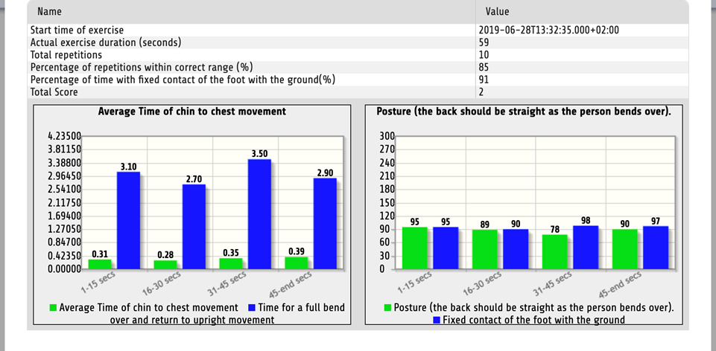
Scoring Module: approach
Accessible interaction with Balance Physiotherapy Hologram and exergames
scoring module
Remote monitoring of performance from physiotherapists
Sensor data collection
Edge computing.
Data synchronization, visualization and processing.
Notes:
This figure depicts the overall workflow of a performed exercise, where sensing devices collect data from a patient and sends them to the edge computer. These data feed the scoring module, which output is used firstly in a real time fashion for the accessible interaction with the virtual coach during the performance of the exercise and with the backend dashboard after it is finished.

Slide 4
Scope TELEREHAB Scoring framework
Exercise assessment module
Online scoring
real time response
short term data
Offline scoring
long term data
patient interaction
scoring after the end of the exercise
input for progressive learning
Offline scoring is crucial for the meaningful interaction with the TELEREHAB_DSS Virtual Coach
monitoring
progressions
“red-flags”
Notes:
In more details, the Holobalance scoring framework include an online function, which drives the messages of the virtual coach and it is based on short-term data and an offline function which consumes all the available data from a performed exercise and scores the patient.

Slide 5
Real Time Scoring Function
For each exercise, a set of knowledge based and empirical rules has been compiled
From these rules, a fuzzy logic algorithm has been designed and tested with data collected from the sensors during performing exercises and annotation (scoring) of the exercises by the physios
The output of the algorithm is binary
- Exercise stop
- Exercise continue
e.g., when the head yaw rotation is more than 30º the user is asked to stop because it is not possible to focus on the target if exceeding the 30º range in each direction
Notes:
The online scoring function is based on a rule based model, which has been produced by modeling empirical rules from the clinicians. Based on these rules, the online function used a window of about 10 secs to assess performance and safety rules and produces messages to the virtual coach.

Slide 6



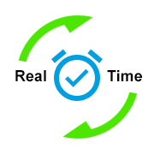
Offline Scoring Function
Real time scoring function “filters” the performed exercises
The “surviving” exercises need to be evaluated (graded)
No clear rules could be acquired
Machine learning approach
Notes:
After the finish of an exercise, all the collected data are shipped to the offline function. As there were no clear rules on how to collectively score an exercise, we followed a data driven approach.

Slide 7
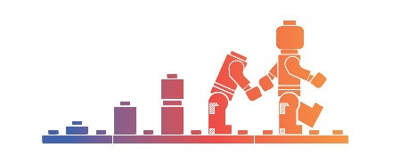
Scoring module Approach
Training dataset constitution
(study on 20 patients)
ML models
Holobalance hybrid Scoring Framework
rules were not sufficient to capture the mechanism of scoring the exercises
knowledge based score (kbscore) is included in the models as a single feature
Notes:
For this, a sub-study with 20 of the Holobalance patients has been performed, aiming to create a training dataset for the machine learning models. It is important to mention that the offline rule-based scoring model of the first version of the Holobalance system is still calculated, but now it is used as a single feature to the final hybrid scoring framework.

Slide 8

Dataset Collection
During a prepilot study (UCL), physicians scored the performed exercises on various aspects, like
Symmetry
Frequency
Amplitude
Velocity
Gait Quality
~58 exercises have been collected
10 sessions
10 patients
1 site (UCL)
Notes:
Thus, we exploit the first phase of the Holobalance clinical study, which took place in the clinics and asked by experts to score the performance of the 20 patients, in terms of symmetry, frequency, amplitude, velocity and gait quality. This resulted to a dataset with 1313 exercises from two clinical sites. By combining the exerts annotations with the data collected by the Holobalance system, we created the training dataset.

Slide 9
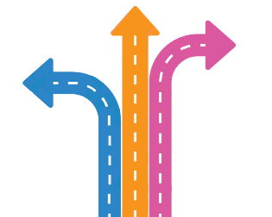
roadmap
Step 1:
For each exercise, the relative analytics are calculated
Step 2:
Group the different exercises (by key categories), in order to produce larger datasets
Step 3:
Train and test different ML models
Notes:
About the roadmap that we have followed, for each exercise, all the metrics and analytics were calculated. Next, aiming to produce as large datasets as possible, exercises with similar features were grouped and finally, different machine learning models were trained and evaluated.

Slide 10
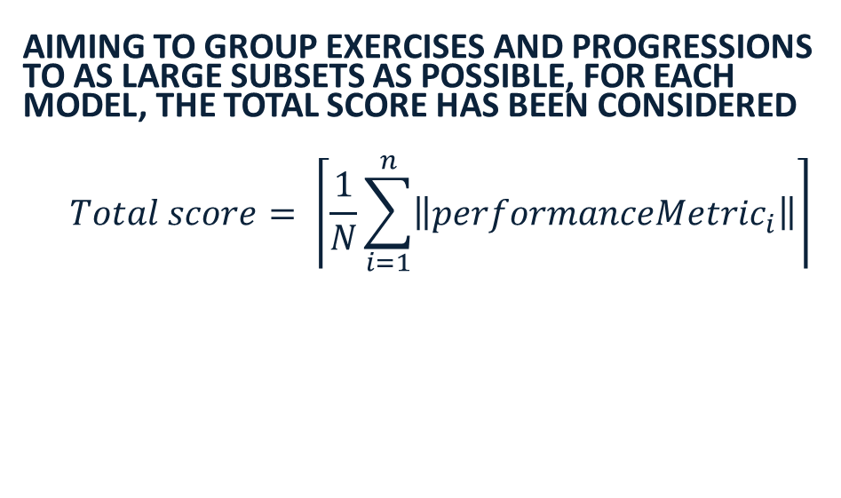
Primary Target (endpoint)
Aiming to group exercises and progressions to as large subsets as possible, for each model, the total score has been considered
$$Total score= \left\lceil \frac{1}{N}\sum_{i=1}^{n}{\left\|perfor{manceMetric}_{i}\right\|}\right\rceil$$
Scoring Scale
0
1
2
3
4-class classification problem
Notes:
About the scoring scale, four different scales has been selected for all different endpoints, like frequency and amplitude. The average of these metrics is finally used as the primary endpoint of the scoring model.

Slide 11
Models training and evaluating
Feature selection
Oversampling
Models training
Feature ranking
Feature elimination
SMOTE
10 fold cross validation
Models ranking
Fernández, A., Garcia, S., Herrera, F., & Chawla, N. V. (2018). SMOTE for learning from imbalanced data: progress and challenges, marking the 15-year anniversary. Journal of artificial intelligence research, 61, 863-905.
Notes:
For the training of the machine learning models, after applying feature engineering and oversampling algorithms, different machine learning models have been evaluated.

Slide 12
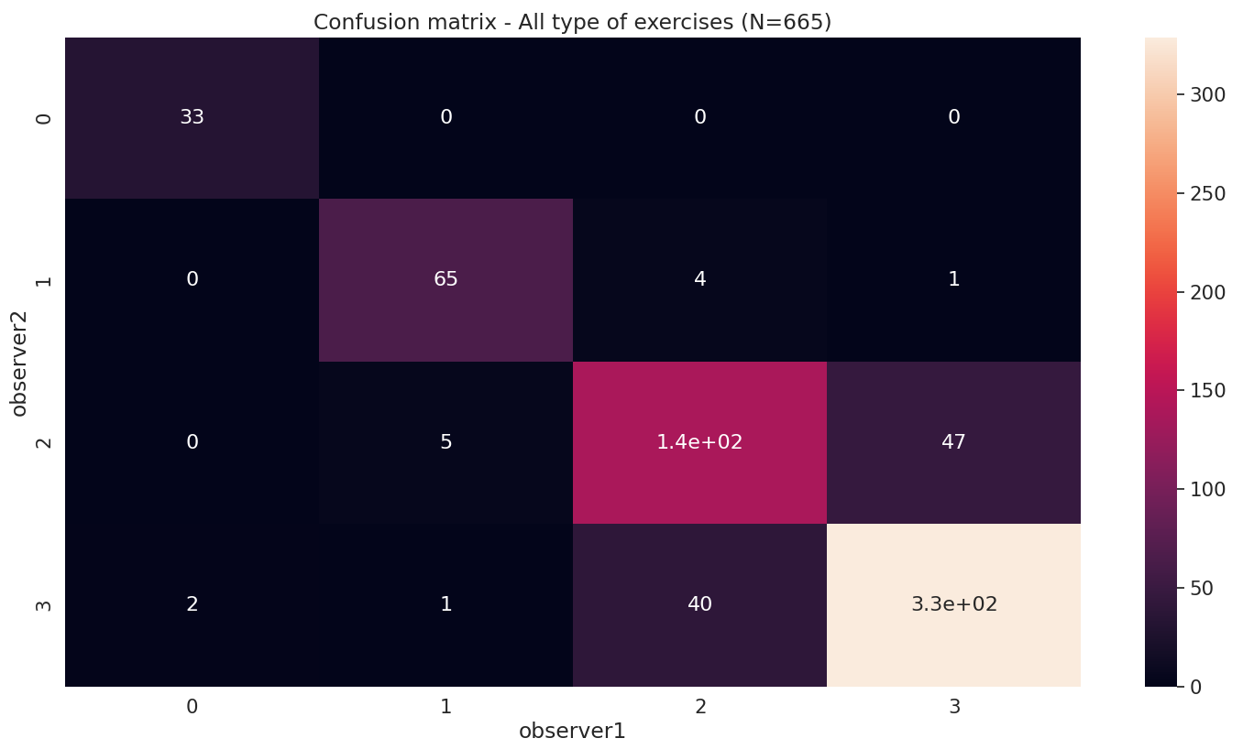
annotations
Notes:
This table presents the annotations of the two observers for all the collected exercises.

Slide 13
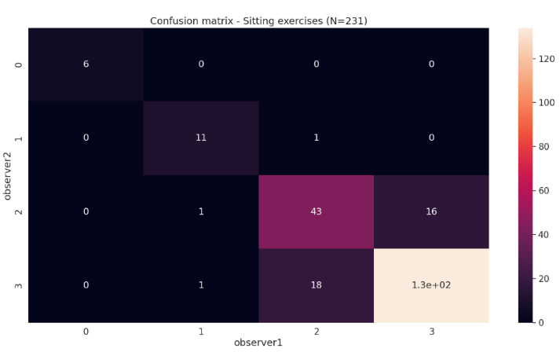
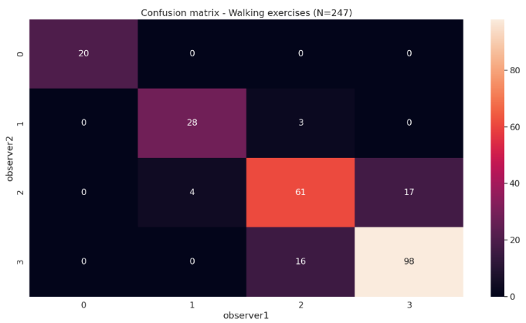
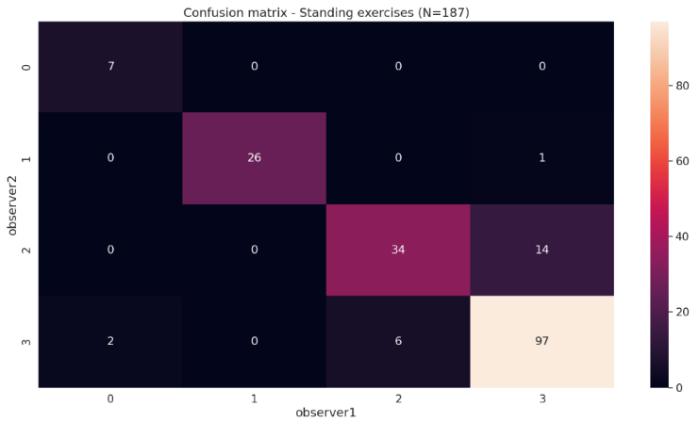
Annotations per type
Notes:
In more details, the produced annotations for sitting, standing and walking exercises are presented.

Slide 14
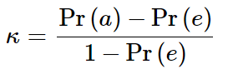
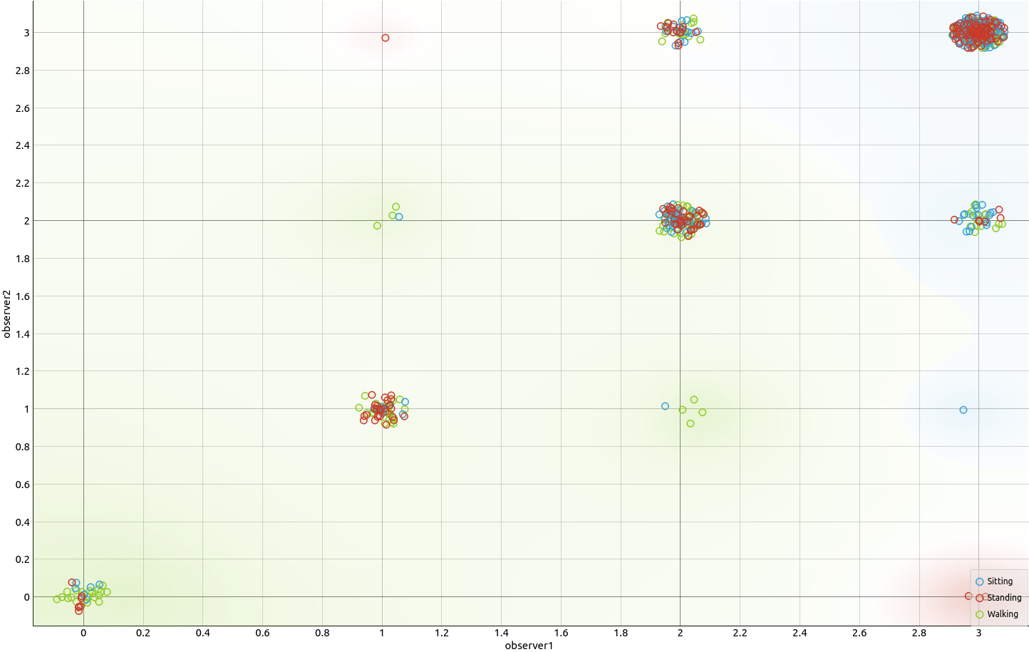
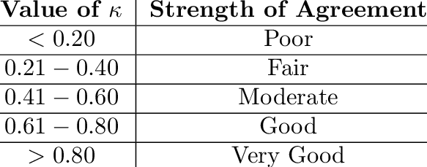
Interobserver Agreement
exercise type | k statistic
all exercises | 0.75
sitting | 0.68
standing | 0.79
walking | 0.75
Observer 2
Observer 1
Wong, T. T. (2015). Performance evaluation of classification algorithms by k-fold and leave-one-out cross validation. Pattern Recognition, 48(9), 2839-2846.
Notes:
The interobserver variability study resulted to 0.75 k-statistic, which is considered as good agreement between the observers.

Slide 15
Scoring models RESULTS
Exercise type | Exercises | progression | CA (Total score) | k statistic (interobserver variability) | k statistic (observer 1 – ML model) | endpoint01 | endpoint02 | endpoint03 | endpoint04
Sitting | 1 |  | 0.90 (Gaussian Process) | 0.68 | 0.69 | 0.90 (kNN) – Movement amplitude | 0.89 (GP) – Movement frequency | 0.879 (GP) – Movement symmetry
 | 2
 | 3 |  | 0.86 (Gaussian Process) |  |  | 0.89 (NN) – Movement consistency | 0.91 (GP) – Movement speed
Standing | 1 |  | 0.853 (Gaussian Process) | 0.79 | 0.77 | 0.826 (GP) – Amplitude | 0.855 (GP) – Movement velocity
 | 2
 | 3 | 0-1 | 0.912 (kNN) |  |  | 0.909 (Adaboost) – Bend-reach speed | 0.916(GP) – Bend reach stability | 0.892 (kNN) – Bend-reach sway amplitude | 0.896 (RF) – Bend-reach sway amplitude
 |  | 2 | 0.8736 (SVM-L) |  |  | 0.889 (GP) – Bend-reach speed | 0.900(Naïve Bayes) – Bend reach stability | 0.884 (RF) – Bend-reach sway amplitude | 0.912 (kNN) – Bend-reach sway amplitude
 |  | 3 | 0.905 (RF) |  |  | 0.896 (Adaboost) – Bend-reach speed | 0.878(NN) – Bend reach stability | 0.855 (kNN) – Bend-reach sway amplitude | 0.888 (kNN) – Bend-reach sway velocity
 | 4 |  | 0.918 (Gaussian Process) |  |  | 0.861 (GP) – Turn Quality | 0.883 (GP) – Turn Speed | 0.799 (kNN) – Turn stability
Walking | 1 |  | 0.899 (RF) | 0.75 | 0.71 | 0.815 (GP) – Gait quality | 0.845 (RF) – Gait velocity | 0.924 (RF) – Toe clearance
 | 2 |  | 0.813 (kNN) |  |  | 0.650 (SVM) – Gait quality | 0.712 (kNN) – Gait velocity | 0.745 (kNN) – Toe clearance
 | 3
Notes:
This is the governing table of the produced machine learning models. We observe that the accuracy of the models varies from 81%, which corresponds to the waking 3 exercise up to 91.8% for the standing 4 exercise. It is also important to mention the comparison between the interobserver variability and the variability of the produced models with one of the observers. As one can notice, the produce models almost resembles the behavior of the experts.

Slide 16
Clinical Relevance
EXERCISE ASSESSMENT
The model will help establish if the patient is performing an exercise correctly, if the exercise is well tolerated and challenging enough
EXERCISE PROGRESSIONS
The model will help establish when to progress the exercise (same exercise / higher level e.g. faster; more difficult exercise in the same category etc.) or when to replace an exercise
PATIENT MONITORING
The model will help evaluate exercise adherence and consistency, provide objective information for patient improvement and potentially identify additional patient needs to be targeted by intervention
RED FLAGGING
The model will help identify movement related symptom triggers (e.g. for headache), and what may trigger falls

Slide 17
Clinical Relevance
PATIENTS’ OBJECTIVE BASELINE ASSESSMENT
NEW BALANCE EXERCISES DESIGN TOOL
LONG TERM MONITORING
CLINICIAN EDUCATION
Running the model on individual patients will educate physiotherapists and medics overtime to understand better the needs of different clinical populations.
RESEARCH CONTEXT
Potentially the sensor based information from this model could be used to monitor long term populations of interest (such as older adults; those with mild cognitive impairment) towards: early prediction of risk of falls and early prediction of cognitive decline (in that balance control requires cognitive resources).
Support clinicians towards evaluating objectively the baseline of a patient when performing the exercises during the first clinic visit, - personalization
The model may help design of new exercises (by a more granular understanding of the patient’s needs and challenges).
Support long term patient monitoring for patients with degenerative neurological conditions (such as ataxias or dementia) that require long term rehabilitation for maintenance purposes.

Slide 18

Progressive Learning module

Slide 19
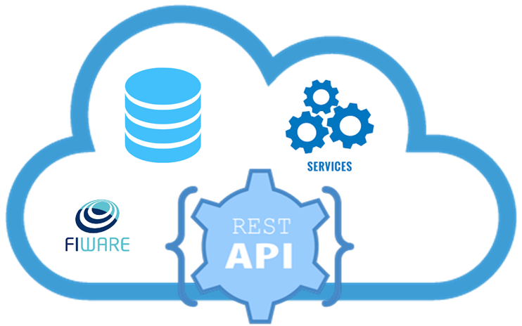
Progressive learning within TelereHAB_DSS ecosystem
Dashboard
T4.1 Cloud Backend (security, repository, FIWARE
Virtual Coaching
WP2
Specs
Progressive Learning
Edge computing – activity planning app

Slide 20
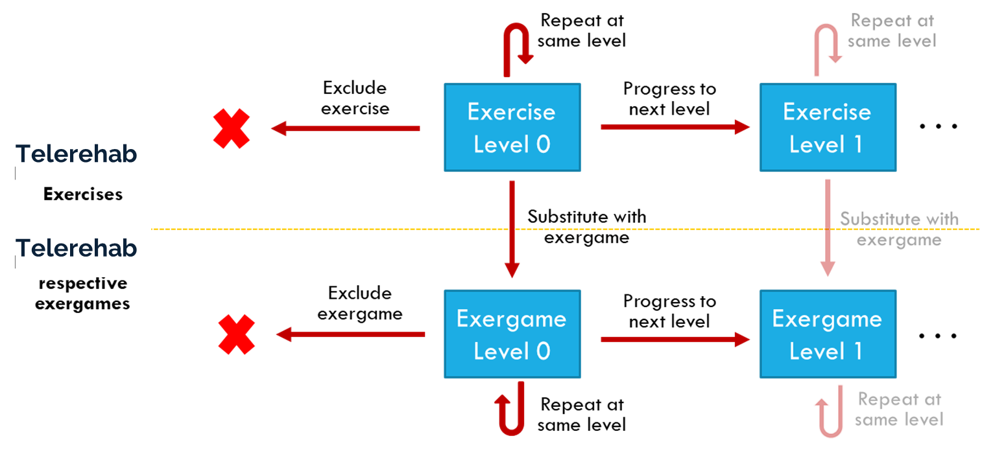
TELEREHAB activities scheduling DSS – Action space
M. Liston et al., "Investigating the feasibility and acceptability of the HOLOBalance system compared with standard care in older adults at risk for falls: study protocol for an assessor blinded pilot randomised controlled study," vol. 11, no. 2, 2021

Slide 21
Telerehab activities scheduling DSS – outcomes
Scheduling decisions are modeled based on weekly activities:
Repeat exercise at same level
Progress to higher level
Substitute exercise with exergame
Exclude exercise
Rehabilitation exercise program schedule changes weekly.
DSS feedback can be provided at any time to clinical experts through the Dashboard.
4-class classification problem

Slide 22
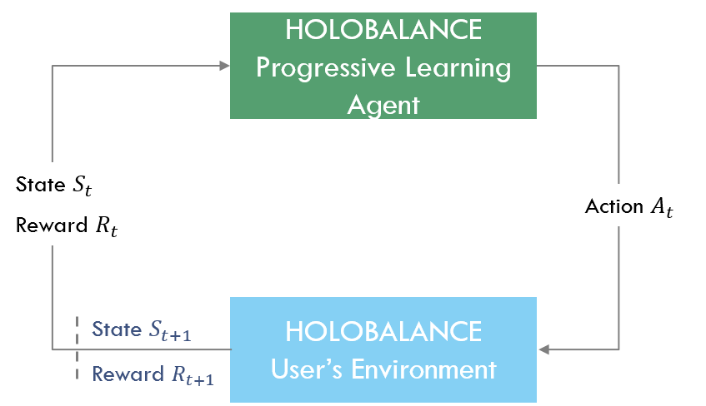
Reinforcement learning models
In the context of HOLOBALANCE activities scheduling DSS:
The agent represents the DSS making suggestions of the next week’s action(s).
The environment is synthesised by all available data that are used by the physiotherapist.
The policy defines the agent's behaviour mapping the state space to the action space.
The reward is a scalar feedback indicating the achievement of the goals.
TELEREHAB_DSS
Progressive Learning Agent
TELEREHAB_DSS
User’s Environment
The Telerehab RL modelling approach is developed by adopting the Q-learning algorithm.
R. S. Sutton and A. G. Barto, Reinforcement learning: An introduction. MIT press, 2018.

Slide 23
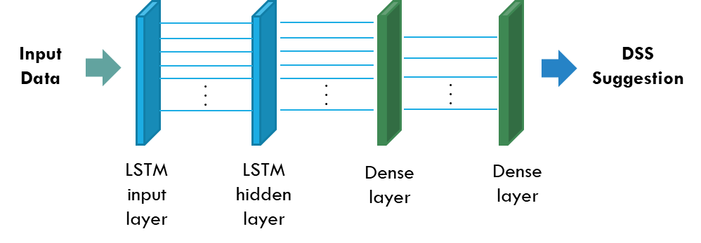
Deep Reinforcement Learning
Introducing Deep Reinforcement Learning models based on LSTM networks to substitute the agent:
(performance, symptoms, frustration, etc.)
S. Hochreiter and J. J. N. c. Schmidhuber, "Long short-term memory," vol. 9, no. 8, pp. 1735-1780, 1997.

Slide 24
Deep Reinforcement Learning
LSTM models have not been used for rehabilitation exercise scheduling before, so there are no indications regarding the optimal network architecture.
A pre-analysis was performed testing 3 different network architectures, moving from simple to more complex networks with increasing number of memory cells and LSTM layers.

Slide 25
Evaluation dataset
For this analysis data from in-hospital HOLOBALANCE intervention groups will be used (i.e. Athens, Greece, Freiburg, Germany, London, UK).
Number of patients enrolled and sessions completed per clinical site and overall:
Hospital intervention group (Holobox) | Clinical site
 | Athens | Freiburg | London | All sites
No. of patients | 16 | 8 | 4 | 28 patients
No. of sessions | 220 | 120 | 66 | 406 sessions
Dropouts | 3 | 2 | 1 | 6 patients
The number of unique data samples available per session is about 25-221.

Slide 26
Feature extraction
Description of the feature matrix for the TELEREHAB intervention at hospital.
 | Feature description | No. of features | Source
Performance scoring | 2-6 score values (depending on exercise) | 2-6 | Annotated by physician
 | Extracted performance features (sum, mean, mul) | 3 | Extracted
Symptoms | Overall evaluation for symptoms (pre-post exercise) | 2 | Annotated by physician
 | Headache, Dizziness, Disorientation, Blurry vision (pre-post exercise) | 8 | Reported by patient
 | Mean value of all symptoms (pre-post exercise) | 2 | Annotated by physician
 | Extracted symptoms features (sum, mean, mul, symptoms change pre-post) | 10 | Extracted
Frustration level | Assessment of patient frustration (after each exercise) | 1 | Reported by patient
Current level of exercise | Level of exercise difficulty (0-3) | 1 | Annotated by physician
Training week | Ascending number of training week | 1

Slide 27



Evaluation Results
Sitting Activities |  | Sessions (12 Patients) | RL Acc. | Deep RL Acc. | Deep RL vs RL
 | Sitting 1 – Yaw | 166 | 57.83% | 75.96% | +18.13%
 | Sitting 2 – Pitch | 164 | 67.07% | 65.01% | -2.06%
 | Sitting 3 – Bend | 154 | 61.04% | 75.19% | +14.15%
Sitting Activities |  | Sessions (12 Patients) | RL Acc. | Deep RL Acc. | Deep RL vs RL
 | Standing 1 – Balance | 120 | 60.00% | 59.62% | -0.38%
 | Standing 2 – Balance Foam | 112 | 69.64% | 71.17% | +1.53%
 | Standing 3 – Bend & Reach | 54 | 51.85% | 69.59% | +17.74%
 | Standing 4 – Turn | 126 | 58.73% | 68.93% | +10.20%
Sitting Activities |  | Sessions (12 Patients) | RL Acc. | Deep RL Acc. | Deep RL vs RL
 | Sitting 1 – Yaw | 90 | 57.78% | 63.89% | +6.11%
 | Sitting 2 – Pitch | 72 | 69.44% | 84.97% | +15.53%
 | Sitting 3 – Bend | 64 | 71.87% | 66.67% | -5.20%
Average: | 62.53% | 70.10% | +7.57%

Slide 28
Evaluation Results – All sites
Sitting Activities |  | Deep RL Acc. (28 patients, All sites) | Deep RL Acc. (12 patients, Athens) | Difference vs Baseline
 | Sitting 1 – Yaw | 75.27% | 75.96% | -0.69%
 | Sitting 2 – Pitch | 61.84% | 65.01% | -3.17%
 | Sitting 3 – Bend | 64.63% | 75.19% | -10.56%
Sitting Activities |  | Deep RL Acc. (28 patients, All sites) | Deep RL Acc. (12 patients, Athens) | Difference vs Baseline
 | Standing 1 – Balance | 62.55% | 59.62% | +2.93%
 | Standing 2 – Balance Foam | 68.37% | 71.17% | -2.80%
 | Standing 3 – Bend & Reach | 65.53% | 69.59% | -4.06%
 | Standing 4 – Turn | 63.84% | 68.93% | -5.09%
Sitting Activities |  | Deep RL Acc. (28 patients, All sites) | Deep RL Acc. (12 patients, Athens) | Difference vs Baseline
 | Sitting 1 – Yaw | 59.10% | 63.89% | -4.79%
 | Sitting 2 – Pitch | 64.18% | 84.97% | -20.79%
 | Sitting 3 – Bend | 57.95% | 66.67% | -8.72%
Average: | 64.33% | 70.10% | -5.77%

